Slide 1
4COSCO11C.2 Web Design and Development
JavaScript Objects Methods, Functions
Week 7

Slide 2


JavaScript Objects
In JavaScript, an object is data, with properties and methods.
When you declare a JavaScript variable like this:
You create a JavaScript String object.
The String object has a built-in property called length. For the string above, length has the value 12. The String object also have several built-in methods.

Slide 3
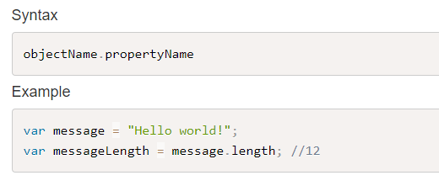
Accessing Object Properties

Slide 4
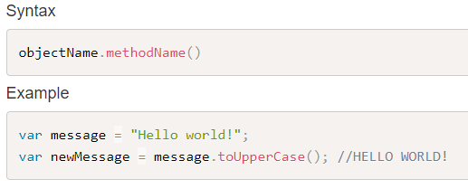
Accessing Object Methods

Slide 5
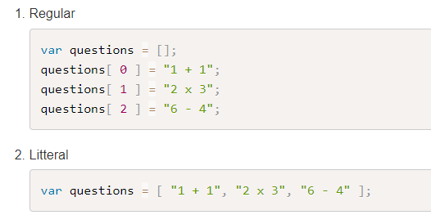
JavaScript Arrays
An array is a special variable, which can hold more than one value at a time. There are various ways of creating an array:
Notes:
const cars = new Array("Saab", "Volvo", "BMW");
The two examples above do exactly the same.
There is no need to use new Array(). For simplicity, readability and execution speed, use the first one (the array literal method).

Slide 6
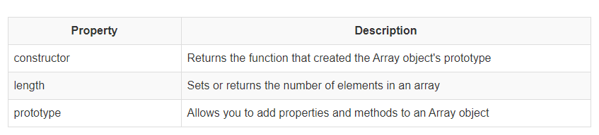
Array Properties

Slide 7
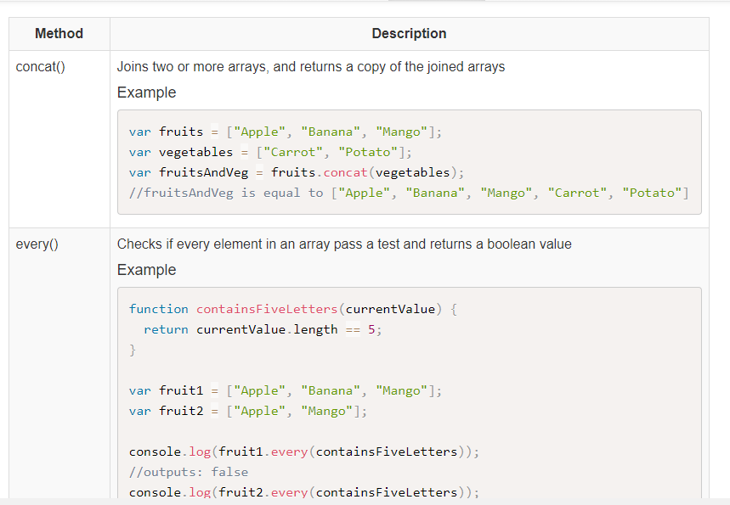
Array Methods

Slide 8
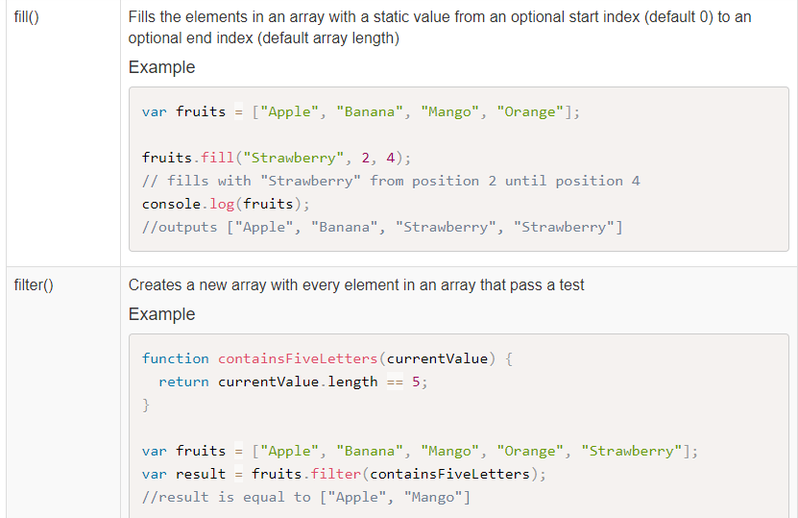
Array Methods

Slide 9
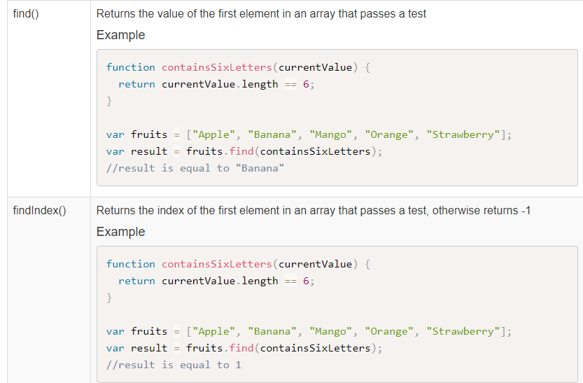
Array Methods

Slide 10
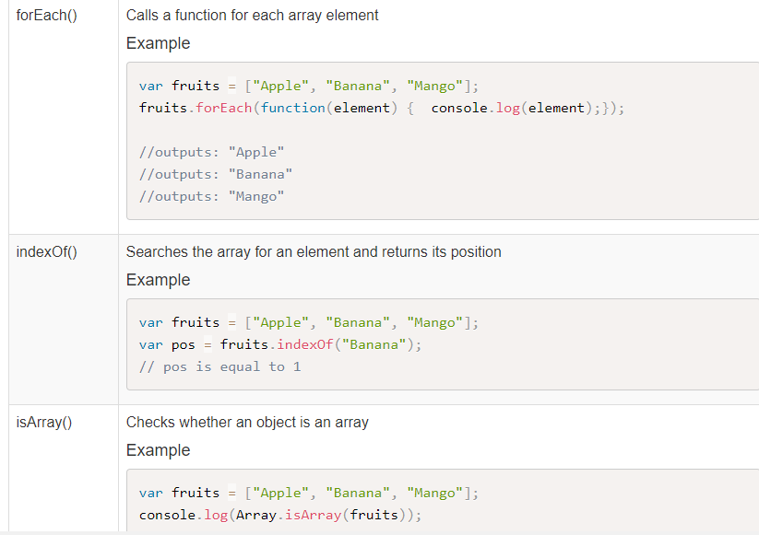
Array Methods

Slide 11
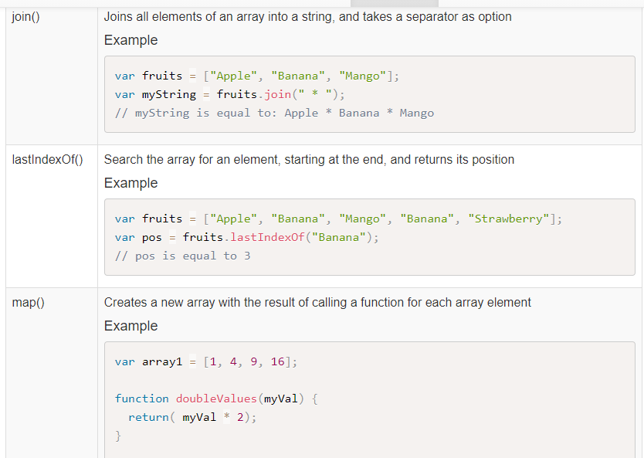
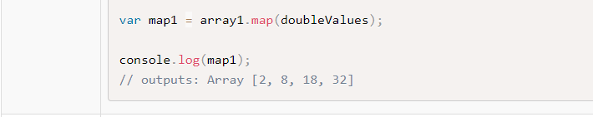
Array Methods

Slide 12
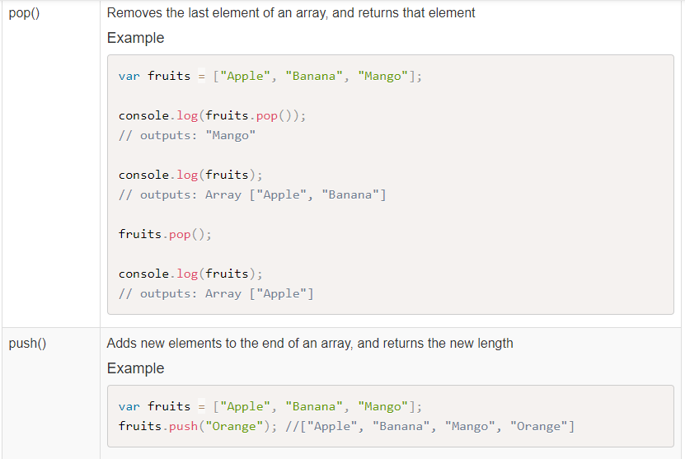
Array Methods

Slide 13
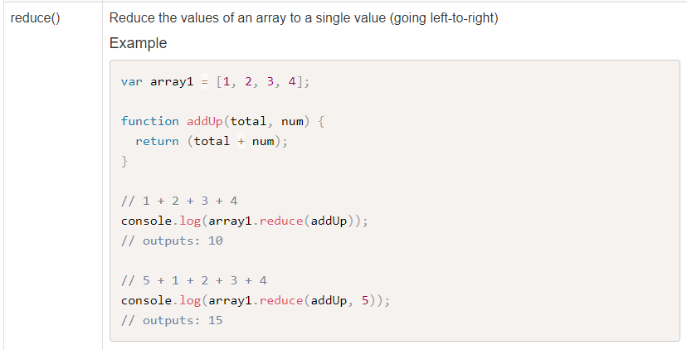
Array Methods

Slide 14
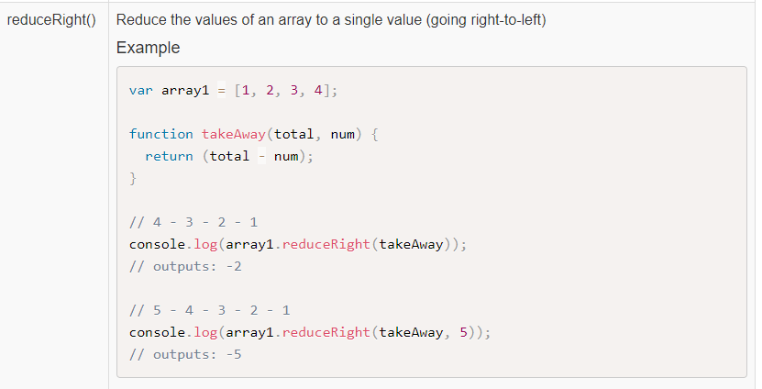
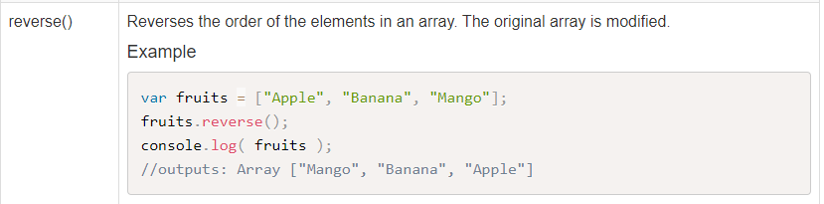
Array Methods

Slide 15
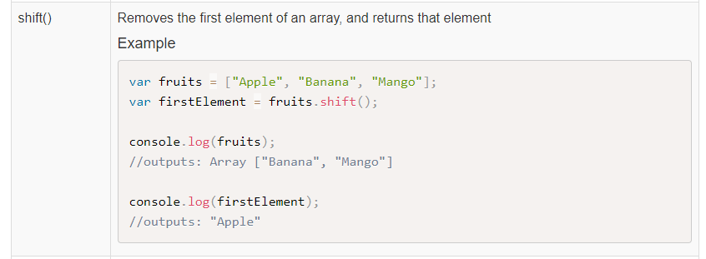
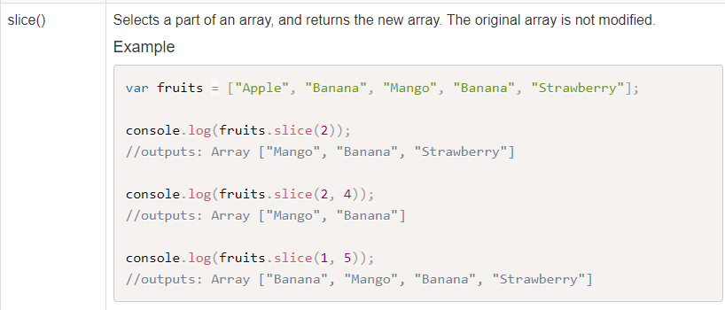
Array Methods

Slide 16
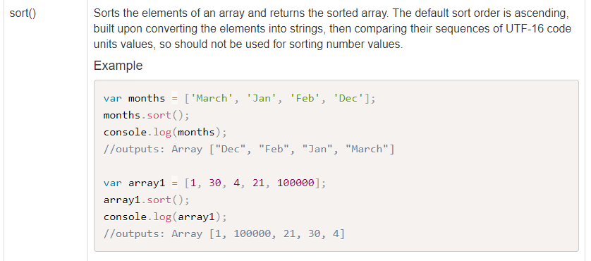
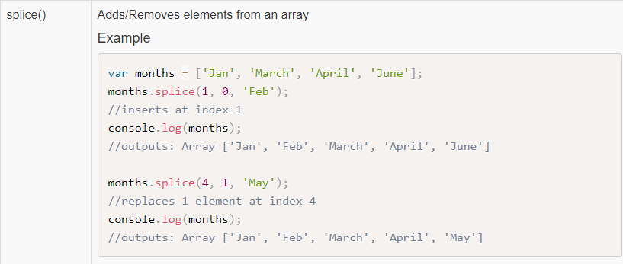
Array Methods

Slide 17
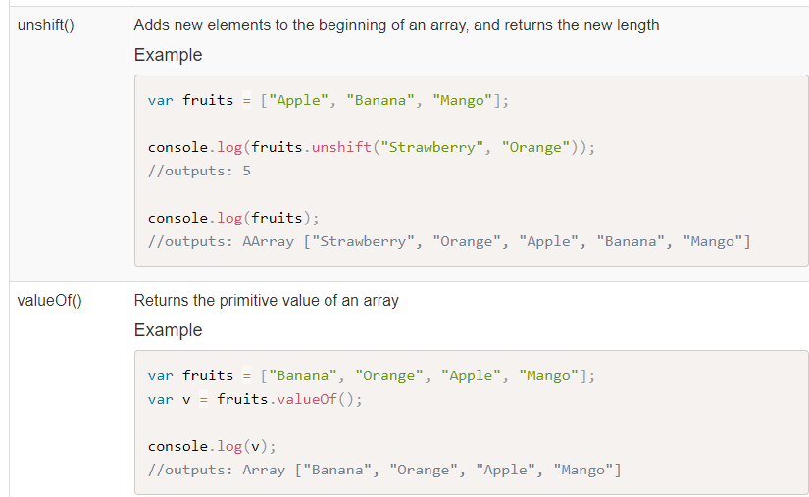
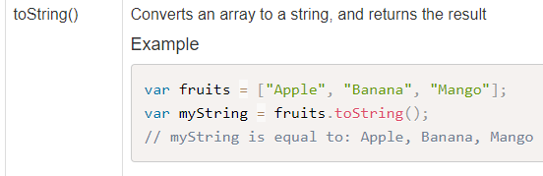
Array Methods

Slide 18
Functions
A function is a collection of JavaScript statements.
These statements usually have a single purpose, such as performing a complex calculation or verifying the data entered into an HTML form.
Functions can be passed copies of objects or variables to work with. This is done in the parameter list.
JavaScript functions can be placed inside script tags anywhere in the document.
However, they should be placed in the head of the document to guarantee they are loaded before being called from script statements in the body of the document.

Slide 19
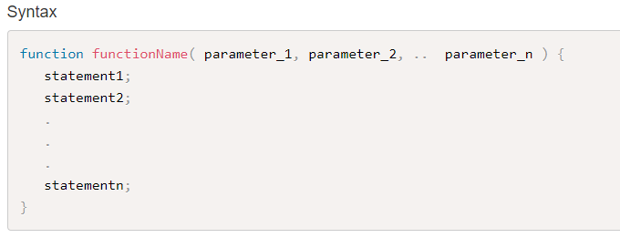
Function Syntax

Slide 20
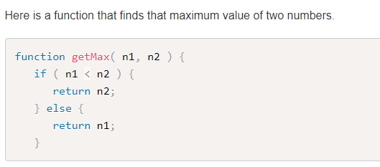
Function Example

Slide 21
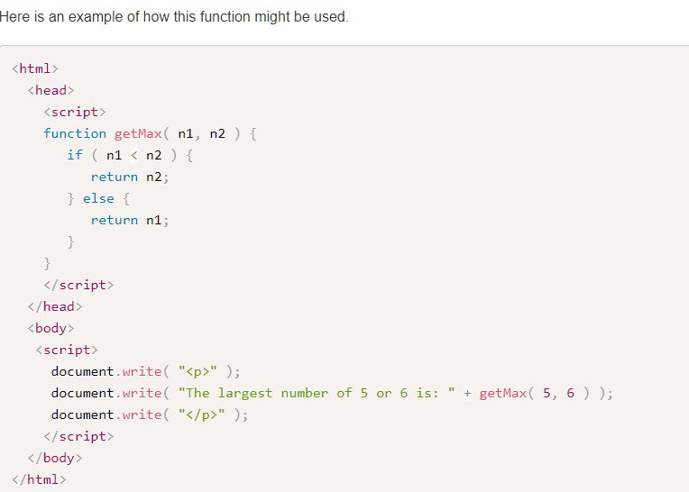
Function Example

Slide 22
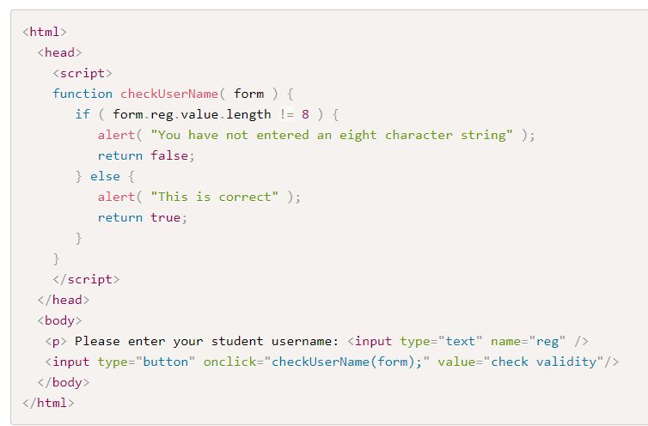
Function Example

Slide 23
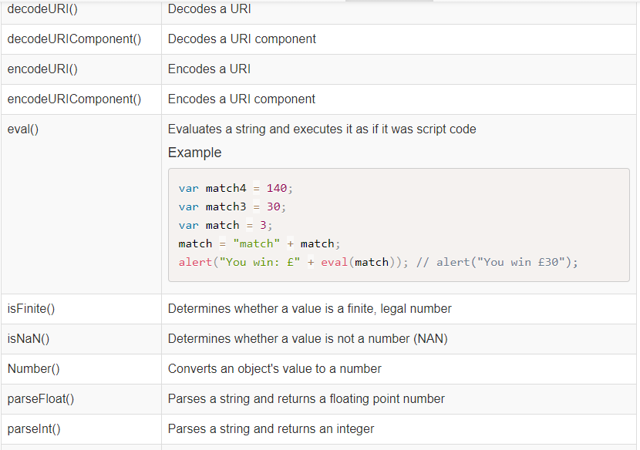
Global Functions
The JavaScript language comes with global properties and functions that can be used with all the built-in JavaScript objects:

